Slide 1

Note: The data and information in this document is reflective of a hypothetical situation and client. This document is to be used for KPMG Virtual Internship purposes only.
Sprocket Central Pty Ltd
Data analytics approach
Nasution Rafly Aulya Rizky

Slide 2
Note: The data and information in this document is reflective of a hypothetical situation and client. This document is to be used for KPMG Virtual Internship purposes only.
Agenda
Introduction
Data Exploration
Model Development
Interpretation

Slide 3
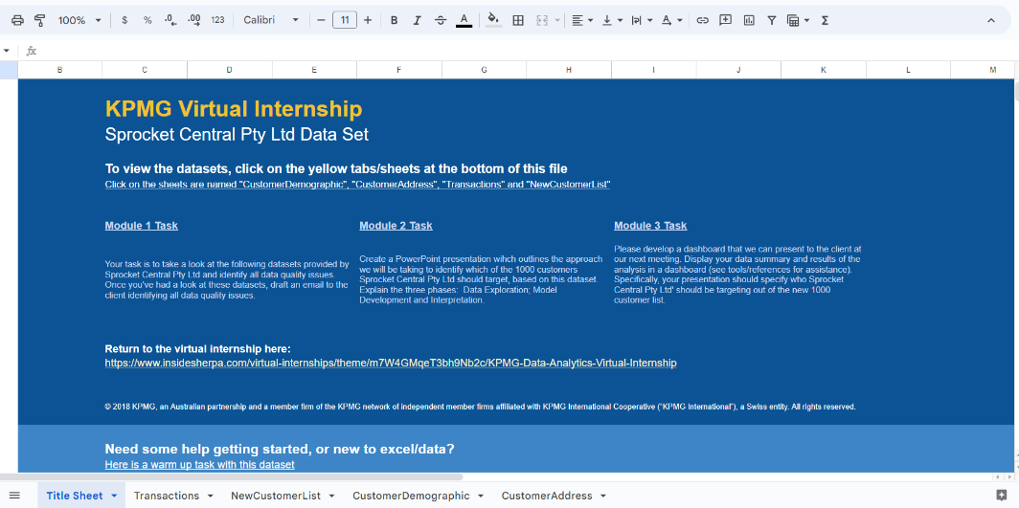
Note: The data and information in this document is reflective of a hypothetical situation and client. This document is to be used for KPMG Virtual Internship purposes only.
Introduction
Targeting high value customers based on customer demographics and attributes
The Sprocket Central marketing team is looking to boost business by analyzing their existing customer dataset to determine customer trends and behavior. And as an Intern KPMG, I need to assist to analyze the data by using the existing 3 datasets, and recommend 1000 new customers should be targeted to drive the most value for the organization.

Slide 4


Note: The data and information in this document is reflective of a hypothetical situation and client. This document is to be used for KPMG Virtual Internship purposes only.
Data Exploration
We want to see if there is any missing or erroneous data. After that, we also want to know what else needs to be done after fixing the data.
After conducting several data analyses using various methods in Google Colab, it turns out that the data provided by Sprocket Central still requires cleaning. This is to ensure that when building models or visualizing the data, the results can be more optimal. Some of the methods used for data cleaning are fillna, dropna, mapping, replace.

Slide 5
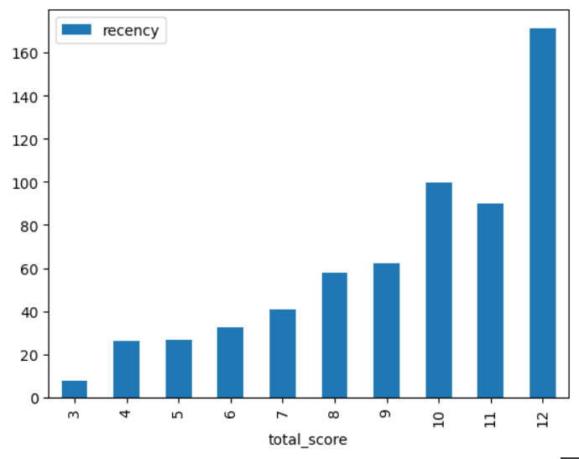
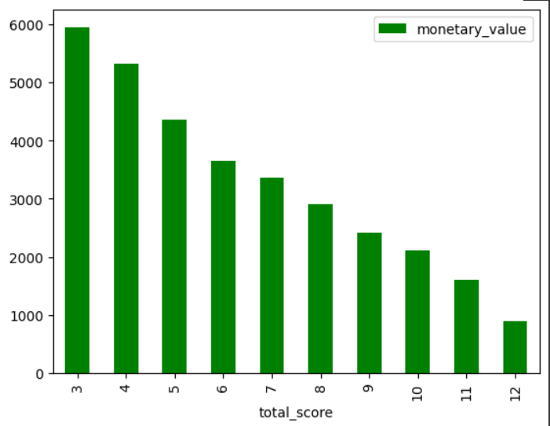
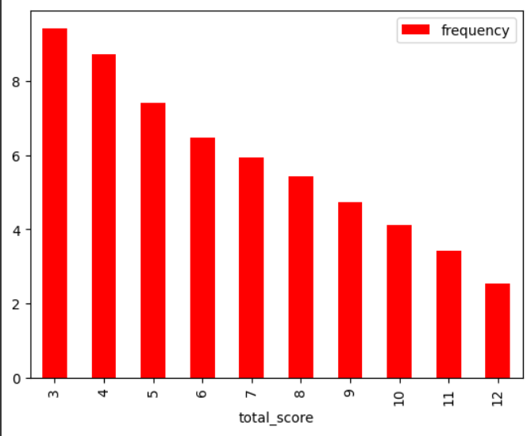
Note: The data and information in this document is reflective of a hypothetical situation and client. This document is to be used for KPMG Virtual Internship purposes only.
Data Exploration

Slide 6
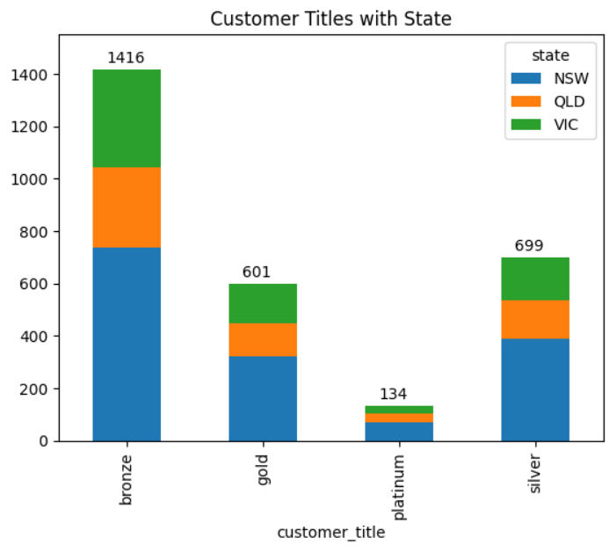
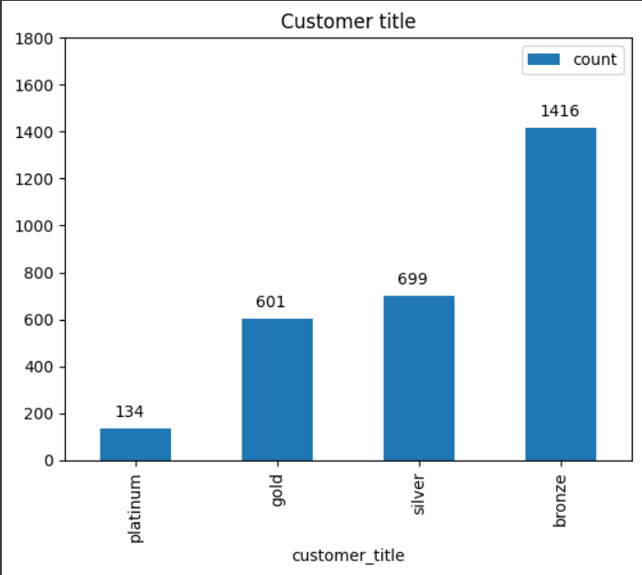
Note: The data and information in this document is reflective of a hypothetical situation and client. This document is to be used for KPMG Virtual Internship purposes only.
Data Exploration

Slide 7
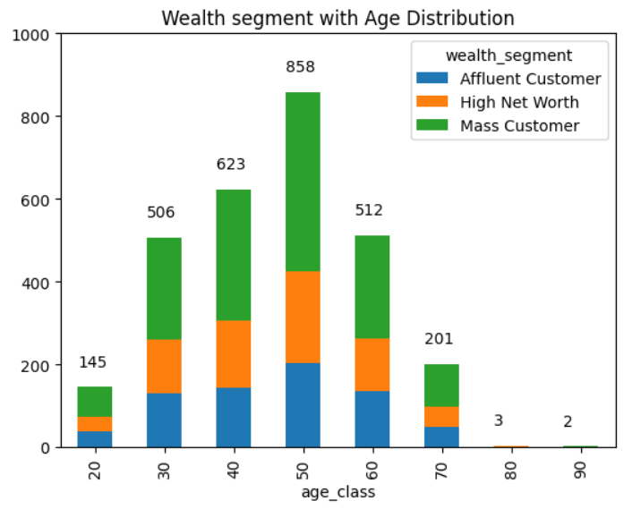
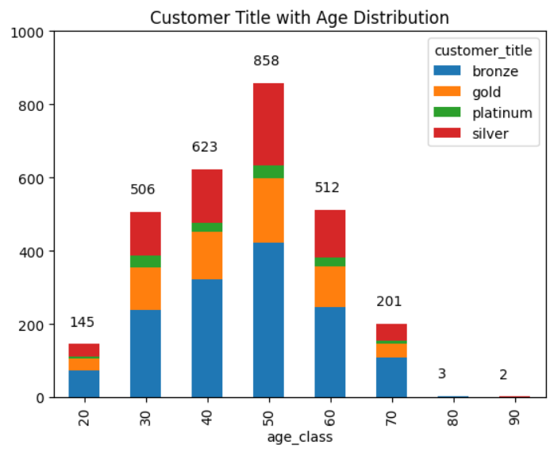
Note: The data and information in this document is reflective of a hypothetical situation and client. This document is to be used for KPMG Virtual Internship purposes only.
Data Exploration

Slide 8
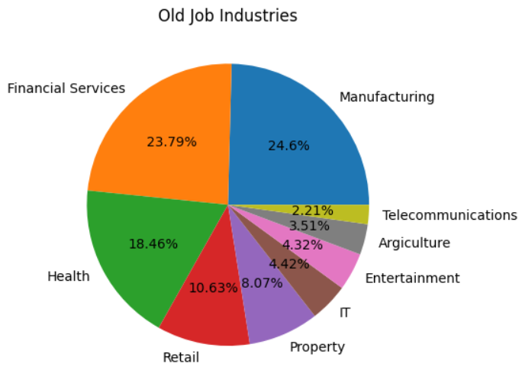
Note: The data and information in this document is reflective of a hypothetical situation and client. This document is to be used for KPMG Virtual Internship purposes only.
Data Exploration

Slide 9
Note: The data and information in this document is reflective of a hypothetical situation and client. This document is to be used for KPMG Virtual Internship purposes only.
Model Development
On this task, I am using a model development called RFM (Recency, Frequency, Monetary)
The RFM (Recency, Frequency, Monetary) model is a data analytics method used for customer segmentation based on three key variables: recency (the most recent transaction date), frequency (the number of transactions), and monetary (the monetary value of the transactions).
Essentially, the RFM method is used to understand customer behavior and identify different customer segments. By using this method, companies can understand which customers are more valuable, which customers are more likely to churn, and gain insights for more effective marketing strategies.

Slide 10
Note: The data and information in this document is reflective of a hypothetical situation and client. This document is to be used for KPMG Virtual Internship purposes only.
Interpretation
Bronze has the highest numbers, followed by silver, gold, and platinum.
The majority of customer titles are located in New South Wales (NSW), and within that, there are more bronze, silver, gold, and platinum titles. The next states in terms of customer titles are Queensland and Victoria.
In the wealth segment with age distribution, the highest quantity is in the age group of 50 years and above, which includes Mass Customers, High Net Worth individuals, and Affluent Customers. Following that, the total is followed by the age groups of 40, 60, and 30.

